Slide 1
CS4499/5599: Data Science and Applied Machine Learning
Class Lecture: March 8th, 2023

Slide 2
Objectives
Last time:
Finished going over feature scaling/normalization
Use Sklearn to split our dataset
Today:
Using Sklearn to train regression models
How to evaluate regression models with Sklearn
Hyperparameters and hyperparameter tunning

Slide 3
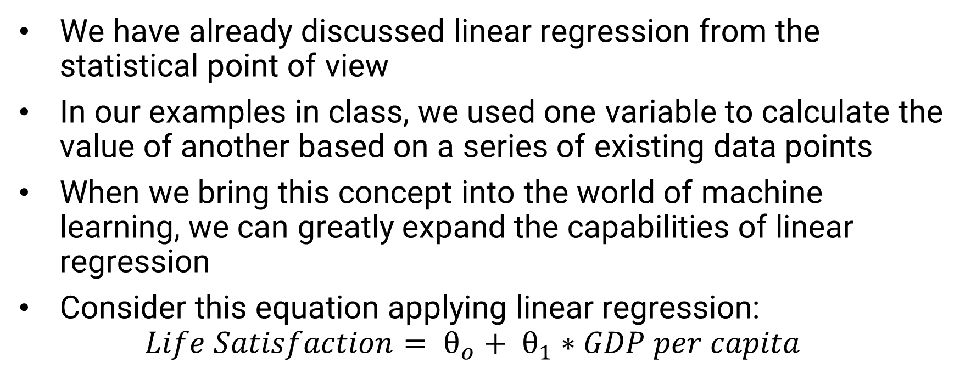
Linear Regression
We have already discussed linear regression from the statistical point of view
In our examples in class, we used one variable to calculate the value of another based on a series of existing data points
When we bring this concept into the world of machine learning, we can greatly expand the capabilities of linear regression
Consider this equation applying linear regression:
$$Life Satisfaction= θ_{o}+ θ_{1}∗GDP per capita$$

Slide 4

Linear Regression
In this form the equation can only account for a single variable to calculate our value
Obviously, this is a significant limitation, as we want to consider several factors that can influence our value
If we apply linear algebra, we can convert our slope value to a vector that can account for several features at once
This is known as a parameter vector and contains the weights for our entire dataset θ_{o} , θ₁ ,……. Θ_{n}. Now our linear regression equation looks like:

Slide 5

Linear Regression
The equation can be simplified to this:
Remember, both θ and x are vectors, and we take the dot product to determine our value
As we add more and more features to our dataset, our model becomes more difficult to calculate (i.e., train our model)
The goal of training is to find a value of θ that minimizes our validation measurement (MSE, RMSE, etc.)

Slide 6
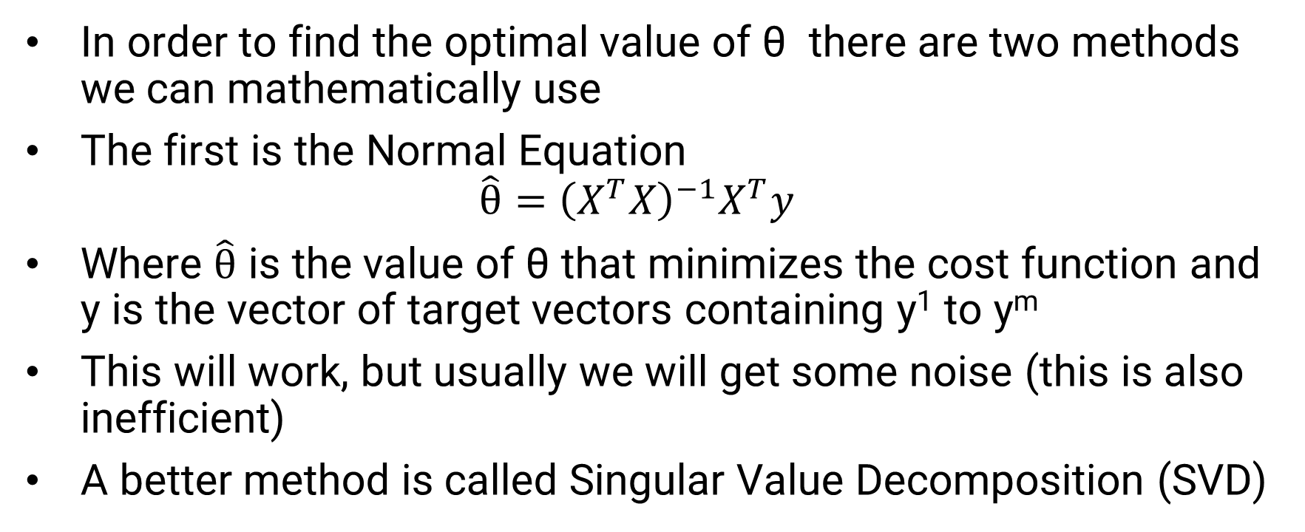
Linear Regression
In order to find the optimal value of θ there are two methods we can mathematically use
The first is the Normal Equation
$$\hat{θ}={\left(X^{T}X\right)}^{−1}X^{T}y$$
Where $\hat{θ}$ is the value of θ that minimizes the cost function and y is the vector of target vectors containing y¹ to y^{m}
This will work, but usually we will get some noise (this is also inefficient)
A better method is called Singular Value Decomposition (SVD)

Slide 7
Linear Regression
SVD will decompose our training set matrix into easier to deal with sub-matrices
The details involve more complex linear algebra, far beyond the scope of this class, but the key difference is efficiency
SVD typically operates in O(n²) while the normal equation can reach O(n³)
Sklearn make use of SVD to calculate θ
The sklearn class is sklearn.linear_model.LinearRegression()

Slide 8
Training Models with Sklearn
Once our data is in a form we are satisfied with, its time to produce our model.
When working with sklearn the first thing we will do is fit our model to the data.
Generally, we specify what kind of model we want to train and call the .fit method.
Ex: my_model = sklearn.linear_model.LinearRegression().fit(feature data, target data)
Most sklearn model techniques have parameters we can adjust (hyperparameters), for right now we will leave things at the default value

Slide 9
Training Models with Sklearn
At this point we have our model trained and is ready for testing.
The first step in testing is to make predictions with our testing data. Sklearn has a handy method we can use .predict
Ex. my_model.predict(testing_feature_data)
Since we are dealing with supervised learning, we need to compare our predictions to the actual results to determine the quality of our model
This is where our testing target data comes into play

Slide 10
Training Models with Sklearn
If you recall from our stats lectures, we evaluate regression models using the mean squared error (MSE) and the root mean squared error (RMSE)
Sklearn has a method to calculate the MSE from the metrics library sklearn.metrics.mean_squared_error()
The 2 primary arguments are the true data and the predicted data
We can get the RMSE by setting squared to false when we calculate the MSE or by taking the square root of the MSE

Slide 11
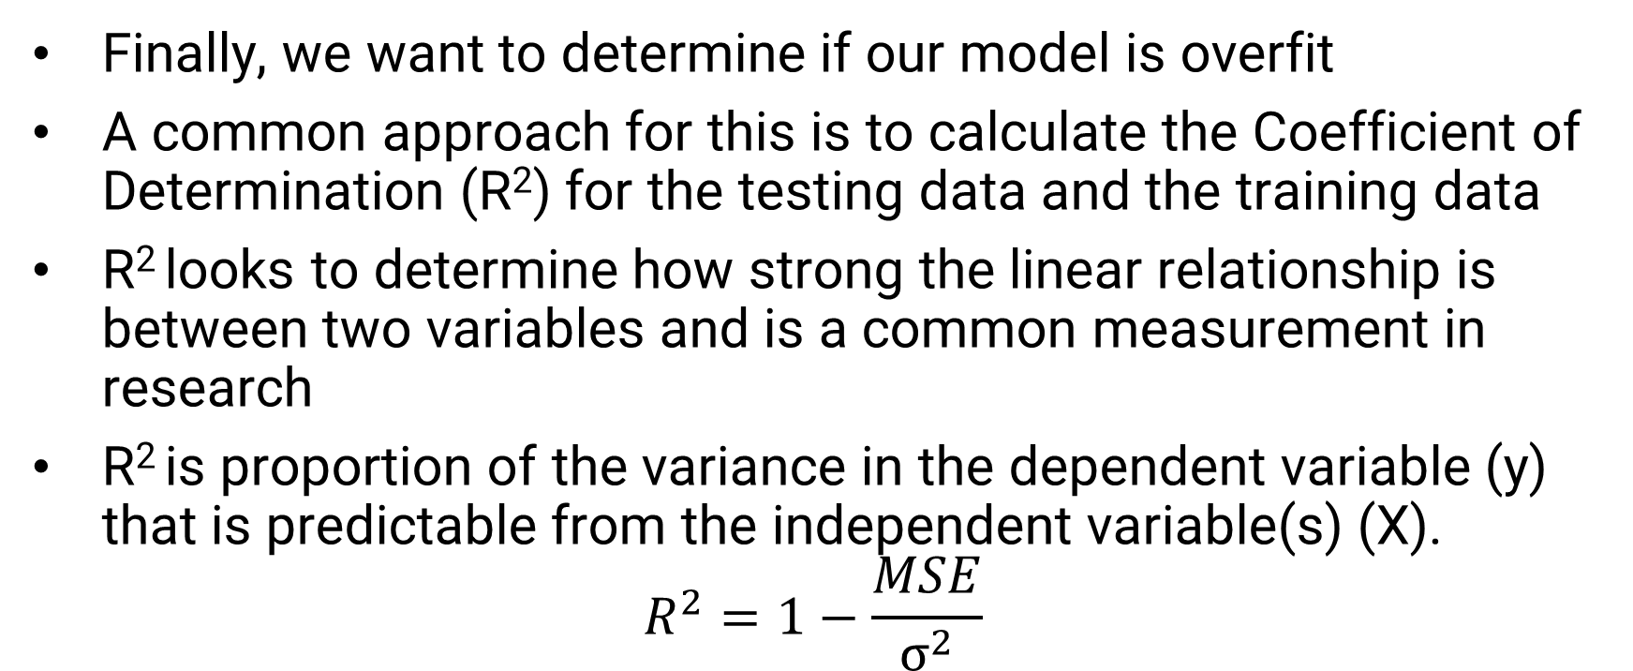
Training Models with Sklearn
Finally, we want to determine if our model is overfit
A common approach for this is to calculate the Coefficient of Determination (R²) for the testing data and the training data
R² looks to determine how strong the linear relationship is between two variables and is a common measurement in research
R² is proportion of the variance in the dependent variable (y) that is predictable from the independent variable(s) (X).
$$R^{2}=1−\frac{MSE}{σ^{2}}$$

Slide 12
Training Models with Sklearn
The linear regression class in sklearn has a .score() method which will calculate this for us
Ex: my_model.score(feature_data, target_data)
A larger R² value means that the model explains the variability around the mean (closer to 1)
To evaluate the quality of fit simply, score the training and target data and compare the results
If the values are “close” the model is likely not overfit
If the R² from the training data is “notably” larger than the that of the testing data, you likely have an overfit model

Slide 13
Other Regression Models
Regression models can take many forms other than linear regression
Many of the classification models we will discuss in this class can produce regression models as well
If regression is something you really want to explore in depth, the math department offers a class that focuses on the field
Let’s go over these briefly
Polynomial Regression
Ridge Regression
Lasso Regression

Slide 14
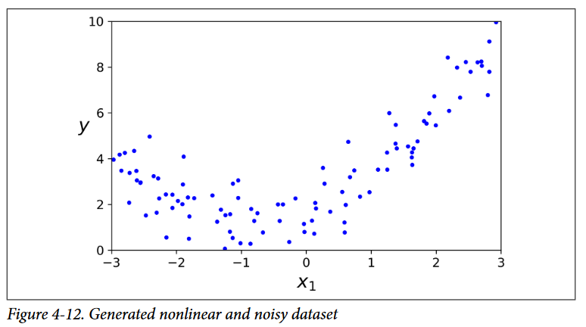
Polynomial Regression
It is not uncommon for the relationship between different features to be non-linear
For example, our data could be quadratic in nature

Slide 15
Polynomial Regression
For this type of regression, the idea is the same, except in said of a line equation we will train a polynomial equation
The advantage is this type of model can find relationships between features
Assume we have a dataset with 2 features a and b and we have a model with 3 degrees of freedom
A polynomial regression model will consider a², b², a³ and b³ combinations
It will also consider combinations for ab, a²b and b²a

Slide 16
Ridge Regression
Sklearn does not have a polynomial regression class (though there are work arounds),but both Ridge and Lasso regression can be trained easily with Sklearn
Ridge regression (or Tikhonov regularization) is useful if your dataset has a lot of multicollinearity (several independent variables with correlation)
Multicollinearity can cause the variances to become large compared to the least squares
This can result in the predictions ending up far away from our actual values

Slide 17
Ridge Regression
Ridge regression uses L2 regularization to try and normalize the parameters
This keeps the coefficients in the equation from getting to large or complex and keeps the model more simple
The class for ridge regression in Sklearn is sklearn.linear_model.Ridge()
We can adjust the effect of the regularization (default 1) by changing the alpha hyperparameter to a different value between 0 and 1
Ex. linear_model.Ridge(alpha=0.5)

Slide 18
Lasso Regression
Least Absolute Shrinkage and Selection Operator Regression or Lasso also makes use of regularization to improve upon linear regression
The key difference between Lasso and Ridge is that Lasso uses L1 normalization instead of L2
Lasso regression tends to remove the weights that have the least importance (which has pros and cons)
The class for Lasso regression is sklearn.linear_model.Lasso,
Remember we evaluate all these models in the same manner (MSE, RMSE and R²)

Slide 19
Next Time
Go over the concept of classification in machine learning
Model Evaluation & Confusion Matrices
Hyperparameters and tunning
If time permits decision trees
You should be able to complete Homework 6, due on 3/15
Expect to receive your midterm project on 3/15 as well

